Slide 1
PROBLEM FIRST
Probably the biggest myth about innovation is that it’s about ideas. It’s not. It’s about solving problems.
Nobody cares about what ideas you have, they care about the problems they have. So don’t worry about coming up with a brilliant idea. If you find a meaningful problem, the ideas will come.
The problem with ideas is that so many of them are bad. Remember New Coke? It seemed like a great idea at first. Yet what the marketers missed is that many had an emotional attachment to the old formula and that created a huge backlash.

Slide 2
Concept Development Process
SELECT AN INDUSTRY YOU CARE ABOUT
IDENTIFY NEW PROBLEMS, or old problems not adequately addressed, or niches not well served.
FULLY RESEARCH THE PROBLEM and MARKET NICHE you want to serve
IDEATION. Generating ideas for SOLUTIONS
EVALUATION. Filtering concepts to arrive at the most promising
VALIDATING the SOLUTION in the MARKET

Slide 3
Current Trends That Will Cause Problems
Artificial Intelligence (AI) and Machine Learning
Robotic Process Automation (RPA)
Quantum Computing
Virtual Reality and Augmented Reality
Blockchain
Internet of Things (IoT)
5G
Cyber Security

Slide 4
Trends >> Problems (Opportunities)
Electric Cars
Self-Driving Cars
Self-driving trucks?

Slide 5
Trends
Global warming
What problems will this create?

Slide 6
Trends
Banned in Washington D.C.

Slide 7
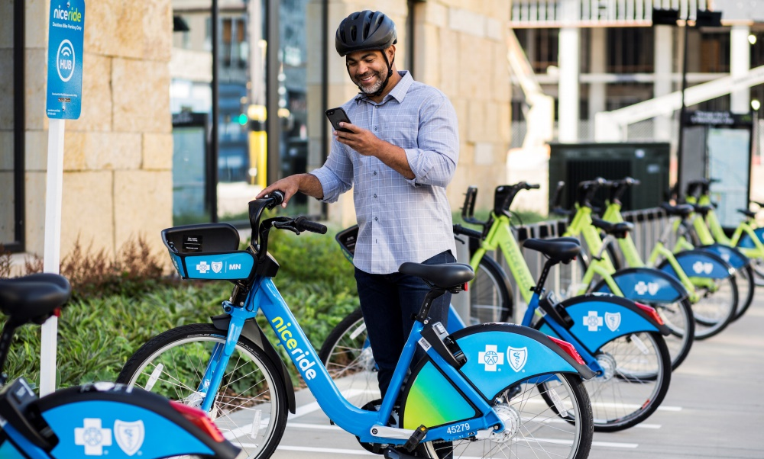
Trends
Millennials want to live in cities.
What problems will they face?

Slide 8
Research
For your chosen Problem, drill down: what causes real pain – and why?
Talk to other consumers.
Talk to people in your industry
Look for new niches (customer segments not now adequately served)

Slide 9
Don’t Jump to Solution Conclusions
If you have already identified a problem and have developed a solution …

Slide 10
Fairfield County Business Accelerator
5:30 - Welcome, Mission
5:40 - Status Reports by Entrepreneurs (#1-4 in 30 seconds)
Name, Company Name
Problem you are solving
Market (demographics of people who have the problem)
Stage: What have you done; what’s next and how can we help?
Observations by mentors
6:00 - Elevator Pitches by Mentors (How we can help)
6:20 - The Problem is the First Problem to Solve
6:40 - Practice Customer Discovery: “Have you had this problem?”
7:00 - Discussions with Mentors around topics of common interest
7:30 - By June 11 become the expert on your chosen problem + interview 20 people about their experiences. Report finding at next meeting plus alternative solutions.

Slide 11
Good Research Questions
Trick is to uncover hidden gems of information, so we can’t ask leading questions.
Be a detective.
INTRO
“Hi, I’m _________, and I’m starting a travel agency; I wonder if I might ask you a few questions about travelling overseas?”

Slide 12
QUALIFYING QUESTIONS Have you ever encountered this PROBLEM?
“What was the last time you traveled outside the U.S.?”
LEARNING QUESTIONS
Did you encounter any problems travelling?
… DRILL DOWN “What was the worst part of that problem?
Do you know of others who encountered this problem?., education level, etc

Slide 13
BE ALERT FOR REVEALED EMOTIONS
“Why” Questions are good: “Why do you think that is?’”
NO “WOULD YOU …?” QUESTIONS
MARKET RESEARCH QUESTIONS (Demographics of Respondent)
Age, Gender, income level, education level, etc.
LEAVE THIS TO LAST.

Slide 14
Fairfield County Business Accelerator
5:30 - Welcome, Mission
5:40 - Status Reports by Entrepreneurs (#1-4 in 30 seconds)
Name, Company Name
Problem you are solving
Market (demographics of people who have the problem)
Stage: What have you done; what’s next and how can we help?
Observations by mentors
6:00 - Elevator Pitches by Mentors (How we can help)
6:20 - The Problem is the First Problem to Solve
6:40 - Practice Customer Discovery on each other and mentors
7:00 - Discussions with Mentors around topics of common interest
7:30 - By June 11 become the expert on your chosen problem + interview 20 people about their experiences. Report finding at next meeting plus alternative solutions.

Slide 15
Discipline Avoid the fatal flaw. Most businesses fail not for a lack of ideas, but for a lack of customers

